Slide 1
The Plymouth Colony
Pages 22-23

Slide 2
After today I will be able to…
Explain the impact the Plymouth Colony had on US history.
Explain why Pilgrims came to America and decided to settle in Massachusetts.

Slide 3
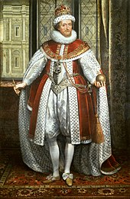
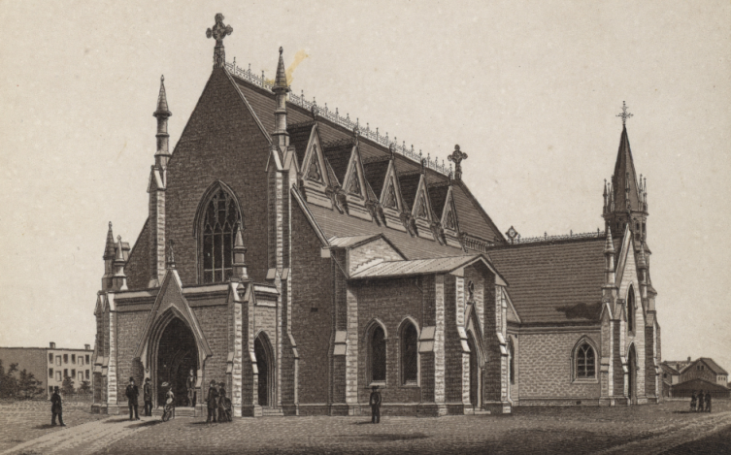
European States and Religion
  In 1500s, Anglican Church was official church of England
    Groups of Separatists wanted to leave because they could lose their jobs/homes

Slide 4
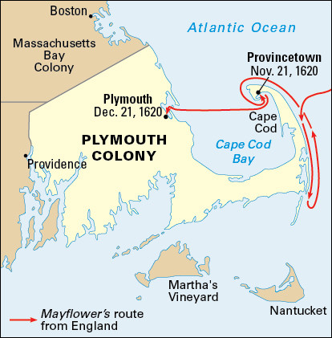
The Pilgrim Colony at Plymouth
Group of Separatists called Pilgrims went to Holland but missed English life
Won a charter to colonize in Virginia
  Late 1620 men, women, and children boarded the Mayflower
    Landed at Massachusetts instead of VA

Slide 5
The Mayflower Compact
Because the Pilgrims didn’t land in Virginia, their charter would not apply to their new colony
  Who would govern?
Pilgrims decided to write/sign “The Mayflower Compact”, a pledge to make and follow laws, elect governor & council
  First form of self-government in America!

Slide 6
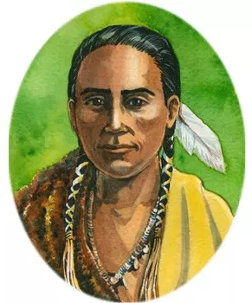
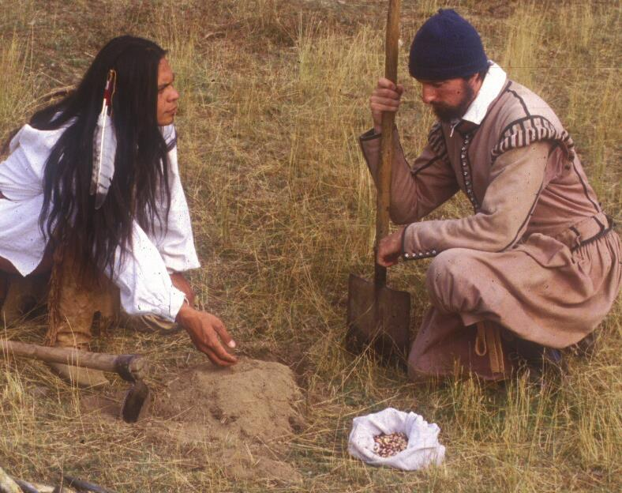
Early Hardships
Growing season over and struggled to survive - Almost half died
By spring, Pilgrims could build crops and met Natives like Squanto, English-speaking Wampanoag man
  Natives taught to plant corn, beans, pumpkins
  Thanksgiving to celebrate harvest
Squanto

