Slide 1
DO NOW
Get notebooks and turn to page 59
There will be no foldable/flaps for notes today

Slide 2
State & Local Governments

Slide 3
What is the purpose of State & Local Governments?
To meet more local needs
But…the national Constitution is still the “supreme law of the land”!

Slide 4
State Constitutions
Each state has its own constitution to lay out its principles and framework of state government
Link to Delaware Constitution
They are similar to the national Constitution – preamble, bill of rights, government with 3 branches

Slide 5
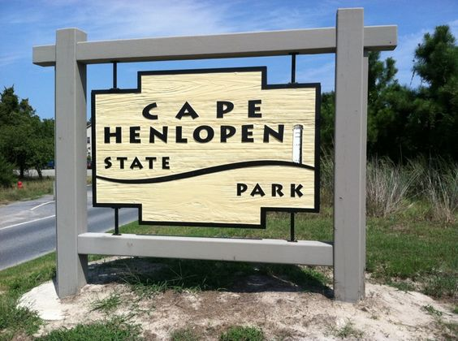
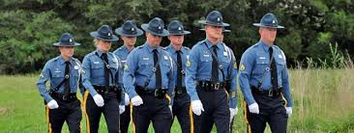
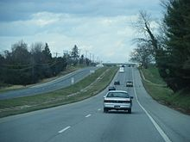
State Governments
Power is defined by the Constitution
Services include* (write 4 in notes):
Maintain law & order
Enforce criminal law
Protect property
Regulate business
Supervise public education
Provide health and welfare programs
Build & maintain highways
Operate state parks & forests
Regulate the use of state owed land

Slide 6
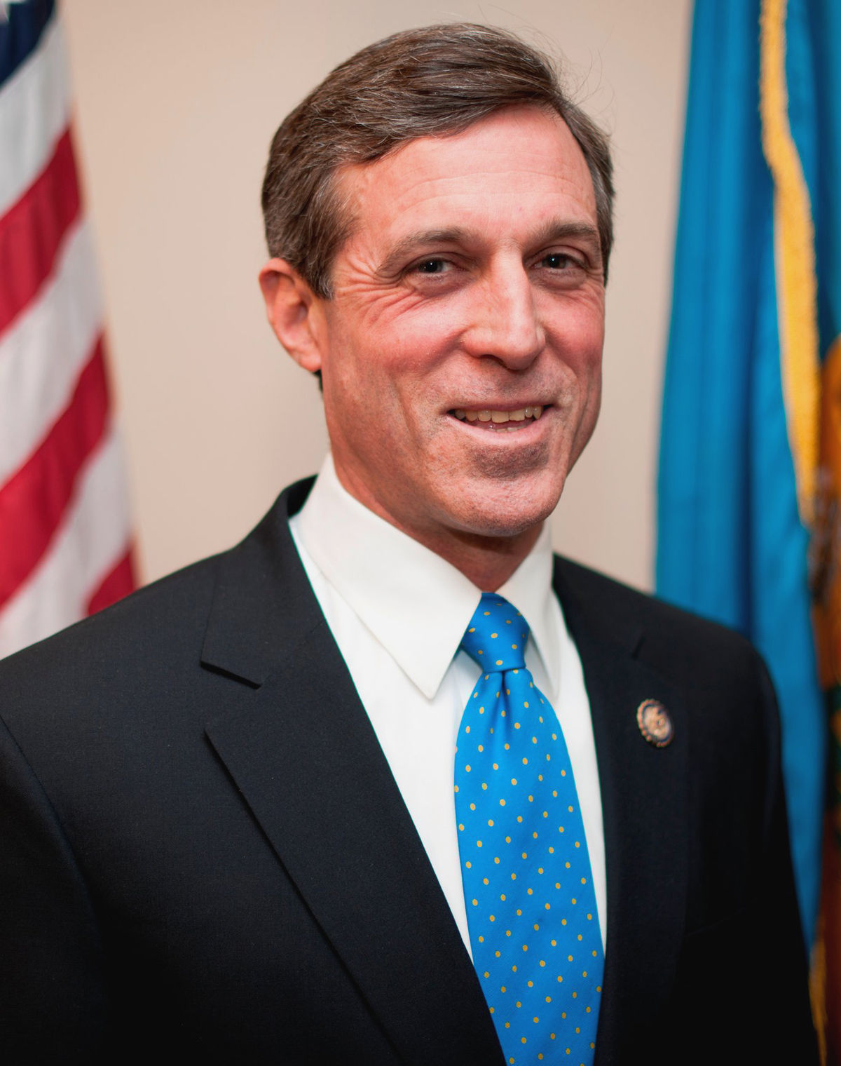
Delaware State Government
State of Delaware
https://delaware.gov/
Governor John Carney
https://governor.delaware.gov/
Delaware State Congress
http://legis.delaware.gov/

Slide 7
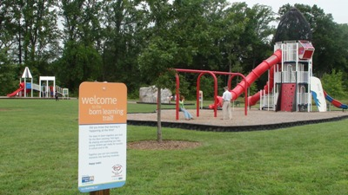
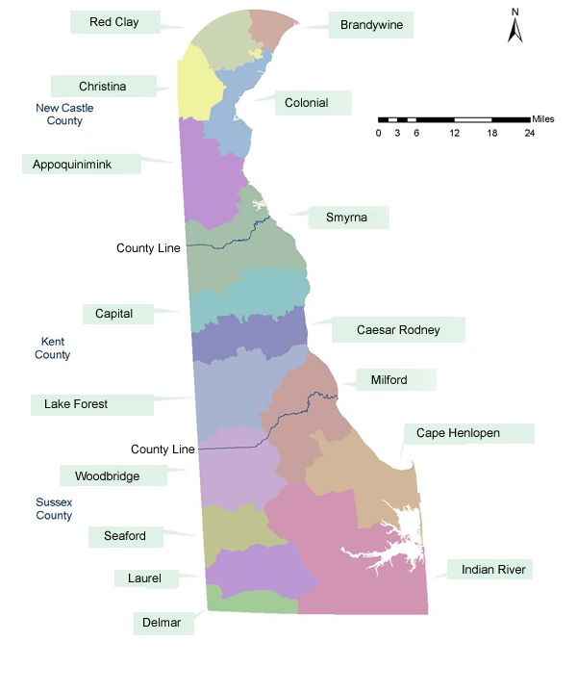
Local Governments
Power is defined by the state
Services include:
Run public education
Hire/support firefighters, police, waste mgmt.
Provide water, maintain local roads and hospitals
Provide libraries parks and other cultural/recreational facilities

Slide 8
Last order of business
Test on this unit will be Friday (will only be one class period – after that you have until next Friday to finish or test will be turned in AS IS)
Homework for the remainder of the week is to get your notebook ready to grade/for the test – see rubric for help
I will update my class website & Schoology with pictures of each page for this unit
Wednesday we answer our Essential Questions and a review game to prepare for our test.
Today we will design the Cover Page for this unit.

