Slide 1
DO NOW
Get notebook and get ready for notes on page 65

Slide 2
The Louisiana Purchase and Exploration

Slide 3
America continues to grow.
By 1803, the states of Kentucky, Tennessee, and Ohio had entered the Union.
The official western border of the U.S. was the Mississippi River.
However, much activity continued to go on beyond that point.

Slide 4
England, France, Spain, and Russia
Spain still claimed territory in the west; as well as Texas.
France gained the Louisiana Territory back from Spain.
Russia had settlements on the Pacific coast all the way to Alaska.
And Great Britain still claimed land in the north (around the great lakes and Canada).

Slide 5
Port of New Orleans
Many depended on use of the Mississippi River and the port of New Orleans for business and trade.
France threatened to bring an end to the United States’ access to the port.

Slide 6
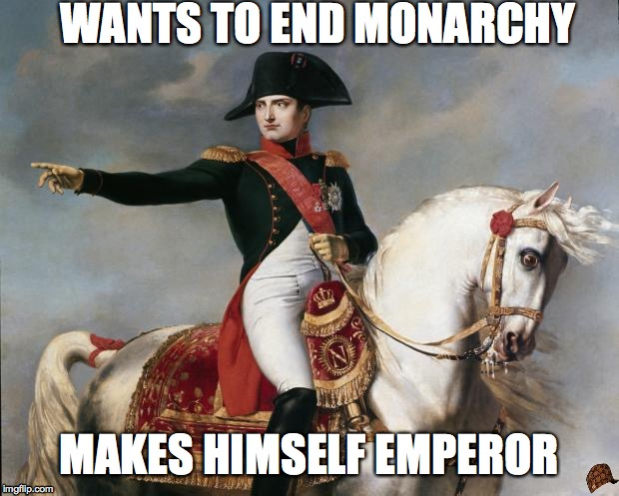
Remember the French and Indian War?
After the French and Indian War, all territory belonging to France, was given to Spain.
However in 1800, Spain signed a secret treaty with Napoleon Bonaparte, emperor of France, giving the territory back.

Slide 7
Napoleon Bonaparte
Napoleon originally planned to colonize the American territory.
But he found himself more in need of money to continue fighting his war in Europe.
Jefferson originally offered to buy just New Orleans from France in order to use the port.

Slide 8
A surprise response
Jefferson received a surprising offer back.
France asked if the U.S. wanted to buy all of the Louisiana Territory.
On April 30, 1803, the Louisiana Purchase was approved for $15 million – about three cents per acre.
This doubled the size of the United States overnight.

Slide 9
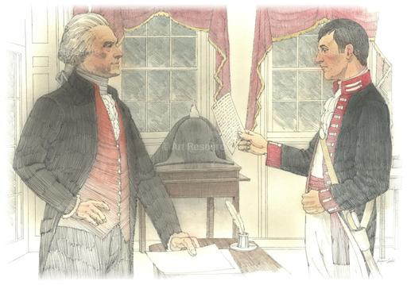
Lewis and Clark
Jefferson felt it was very important to begin exploring the newly purchased territory.
He chose Meriwether Lewis as the Captain and they began eagerly planning.

Slide 10
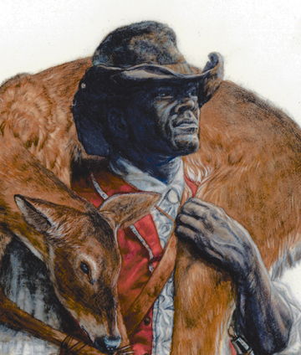
Lewis turns to his old friend Lieutenant William Clark to select and oversee a volunteer force.
Clark was joined by his slave, York.
York was the 1st black man many Natives had ever seen. He became something of a celebrity among them.

Slide 11
Lewis & Clark
Their job was to:
Explore the Louisiana Purchase
Map it
Record the landscape, animals, and plants
Establish good relationships with Native Americans
They hoped to find a water route across the continent.

Slide 12
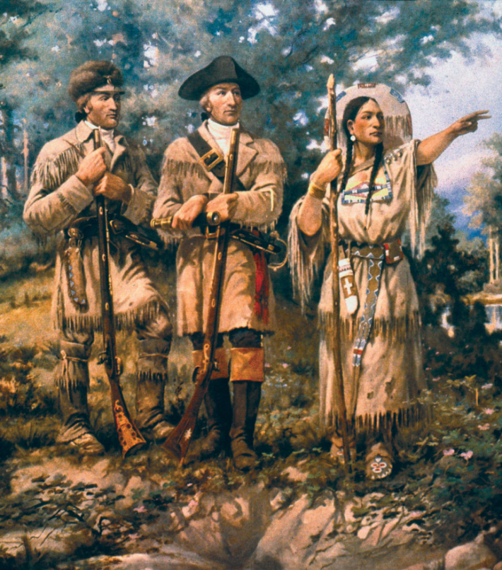
Sacagawea
After spending the winter of 1804 with the Mandan Indians, Lewis and Clark continued their expedition with a guide.
Sacagawea was a 17-year-old Shoshone Indian and wife of a French trapper.
Her language and geography skills proved to be a great value for the expedition.

Slide 13
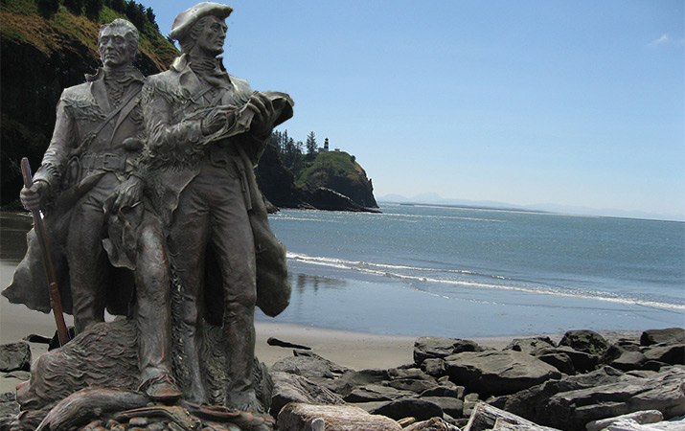
Reaching the Pacific!
Although they didn’t find an all water route to the Pacific, they did reach it.

